Slide 1

Beauty Fashions Ltd
Saloni Shah
Sudharsan Ramani
Wei Cheng

Slide 2
Beauty Fashions Ltd – Company Profile
Beauty Fashion, Ltd (BFL) located in Miami, Florida is an importer, wholesaler, and exporter of high-fashion clothing, principally jeans, shirts, swimwear and other men’s and women’s wear.
They import mostly finished goods, make some changes and add their house label and the sell to end buyers in other countries.
Its sales are 75 percent to domestic companies and 25 percent to foreign markets

Slide 3
BFL’s concern
For Importing from Heng Fashion (China)
For Exporting to Cancun Imports (Mexico)
Advance on sight payment
Managing Cash flow
Foreign Exchange Risks involved
CIL wants to use open account as a payment method.
CIL requires a 60 days credit term for the payment.

Slide 4
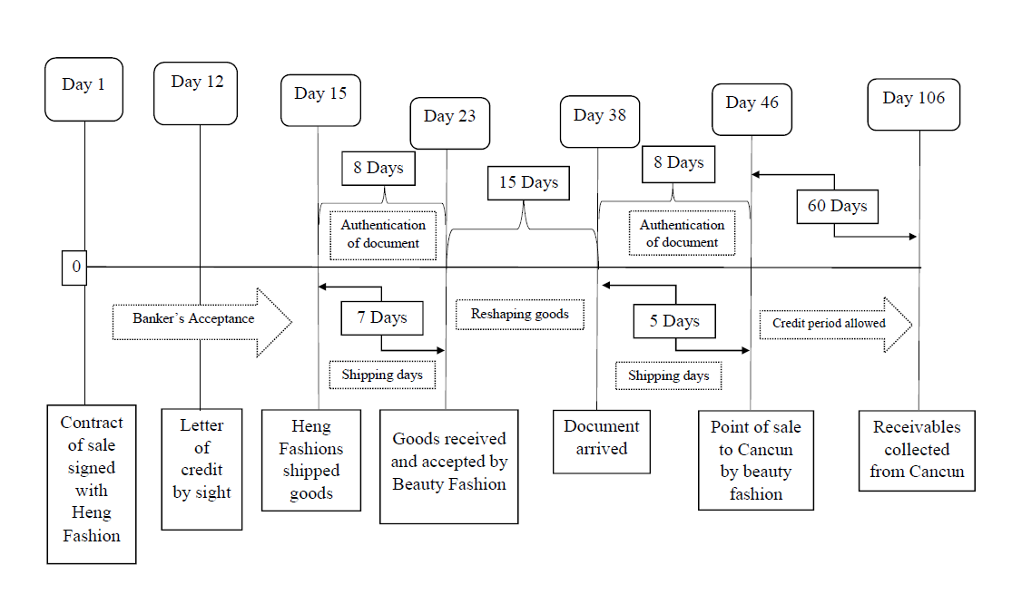
TIME LINE (Trade Cycle) Import and Export transactions

Slide 5
Terms & conditions for import transaction between BFL and HF
The import transaction between BFL & HF will be carried on CIF basis
The full payment of $1,000,000, for the goods exported by HF will be honored by way of Letter of credit by sight through issuing bank and will be transferred only when the original shipping documents are handed over by advising bank to the issuing bank
The goods to be imported by BFL shall be shipped within 15 days of signing this contract.
The payment shall be made to HF in Chinese Yuan ¥ through a forward contract of 30-day period by fixing the rate to 7.03 USD/CH¥.
The goods will be accepted only if they are in the desired quantity, shape, size, color, material, quality as per the sample provided earlier by HF.
In case the goods are damaged in transit, the buyer will be not be held responsible for acceptance of the shipment and the cost has to be borne by the exporter or the insurance company
The conversion cost of the foreign exchange in home currency will be borne by BFL

Slide 6
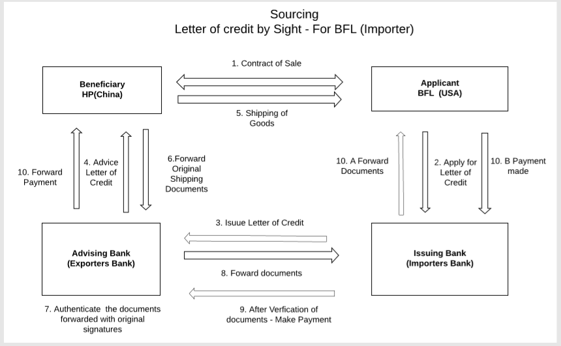
Import transaction – Method of Payment

Slide 7

Import Transaction – Requirement of documents
Contract of sale
Commercial invoice
Packing List
Certificate of Origin
Bills of entry
Bill of lading
Import License
Insurance certificate
Purchase order/letter of credit

Slide 8
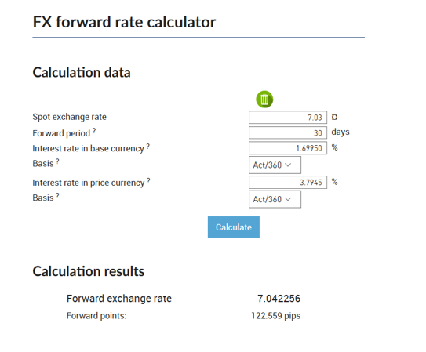
Foreign Exchange for payment (Import)
The Product will arrive from China and the worth of the product will be a million dollar.
The bank recommends Beauty fashion pay in Chinese Yuan rather paying it in USD
The Bank acknowledges that there is a significant risk in paying in Chinese Yuan ¥. However, the bank will help Beauty Fashion in purchasing a forward contract to mitigate the risk due to foreign exchange volatility
If not considering the forward rate prediction, for the same transaction the company might need to pay $7,040,000 instead $7,030,000, which clearly states the $10,000 more in total and leading to additional loss.

Slide 9
Terms & conditions for Export transaction between BFL and CIL
The export transaction between BFL and CIL will be carried on FOB basis
As per the commercial contract, BFL will provide a 60-day credit period to CIL which will be calculated after the shipment of goods.
The payment to be made to BFL will be in Mexican Peso by employing Letter of Credit by acceptance through CIL and the issuing bank.
Once the goods are shipped, the beneficiary will no longer be held responsible for them for their damage due to any natural or man-made interference.
The cost of converting foreign exchange will be borne by BFL i.e. the Beneficiary.
In the event, if the payment is not honored within the stipulated time, BFL will have every right to sue CIL in the court of law and jurisdiction will be the USA for all legal purposes.
In the event of legal proceedings between BFL and CIL, in case BFL wins against CIL the legal expenses will be required to be reimbursed to BFL by CIL.
BFL will employ forward rate of contract for 120 days and fix the rate prior to 0.0511 for 1 USD/ Mexican Peso.

Slide 10
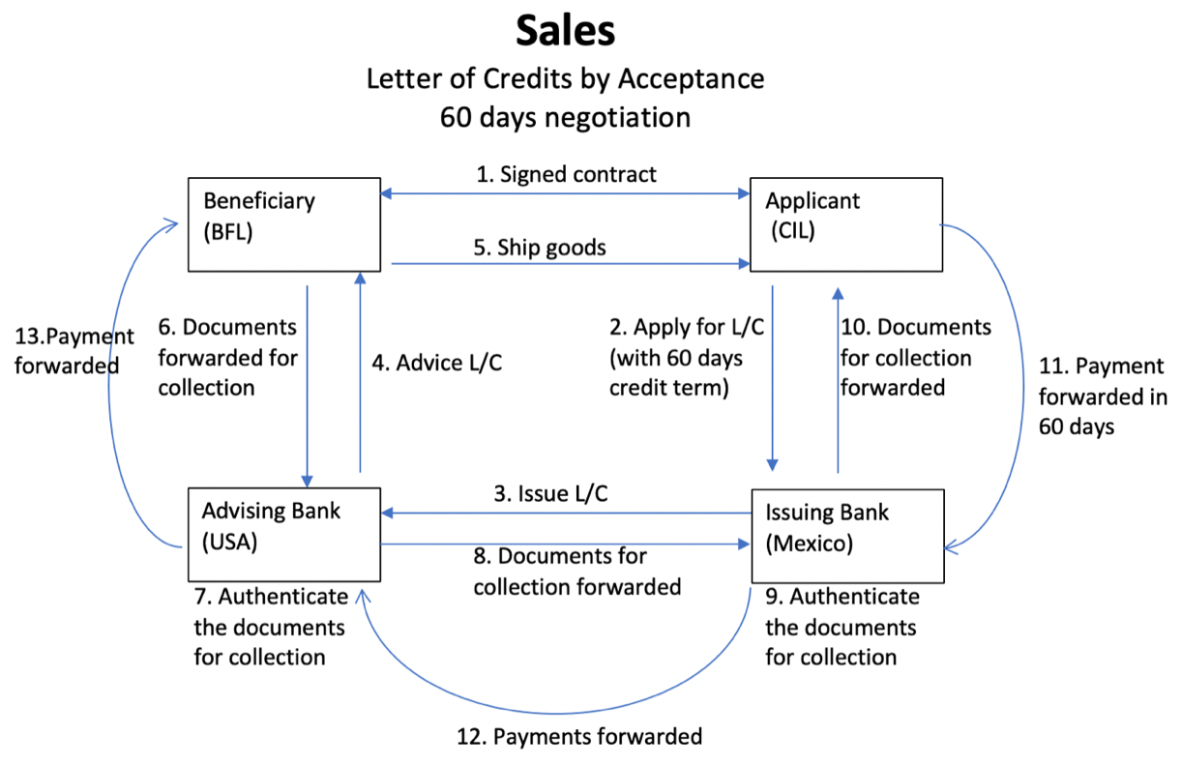
Export Receivable Method

Slide 11

Export Documents
Commercial Invoice
Trade Credit Information Report
Export Packing List
Certificate of Origin
Shipper’s Letter of Instruction
Pro Forma Invoice
Bill of Lading
Letter of Credit
Export Credit Insurance

Slide 12
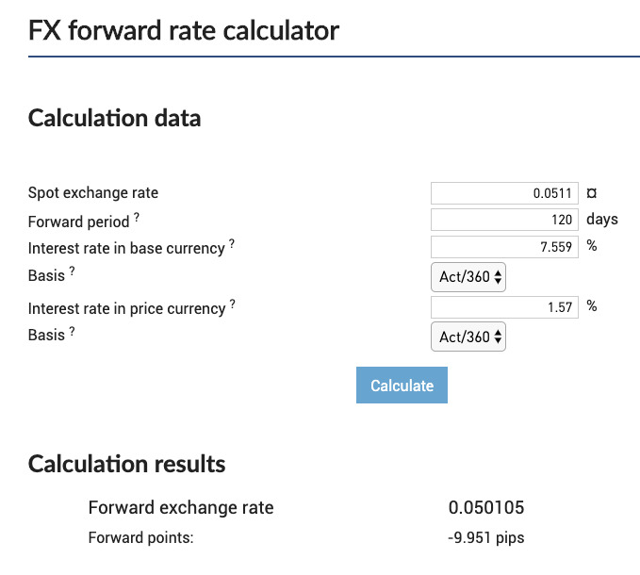
Foreign Exchange Product for Receivable
Receiving the payment in 106 days.
$\frac{0.050105−0.0511}{0.0511}∗\frac{360}{120}∗1$00%=-5.8%
MXN is very weak against USD
High T-bills rate,
forward currency depreciate
Sign a forward contract with our bank
Sell at 0.0501 in 106 days

